Slide 1
Empowering
Education: A Comprehensive
Database Solution for Enhanced School Management
Team Pangolin

Slide 2

INTRODUCTION
Challenges
The role Of Technology in School Management
Deliverables
Project Phases
Database Information and Tables
EER Diagram
User Interface and Security
CONTENTS
Measures
Resources & Budget Overview
Conclusion
Questions?

Slide 3

Current situation: School operates across three branches with approximately 2,400 students.
Challenges with existing Excel-based-system:
Limited accuracy and efficiency in managing data.
Proposed solution: Implementation of a database system to streamline processes and improve accuracy.
INTRODUCTION
Benefits of the new system: Expected reduction of manual workload by 30%, ensuring data accuracy, and providing instant access to student performance.
Vision: Modernizing educational management for enhanced efficiency, reliability, and adaptability to future needs.

Slide 4
Challenges in Data Management Systems
01
Data Fragmentation
02
Lack Of Integration
03
Security Concerns
Student Information is scattered across platforms,leading to inefficiencies and inaccuracies
Absence of a centralized database results in disjointed communication
Without a centralized system, data security becomes a major challenge.

Slide 5
THE ROLE OF TECHNOLOGY IN SCHOOL MANAGEMENT
01
Efficient resource Allocation
02
Data-Driven Decision Making
03
Enhanced Parental Engagement
Facilitates optimized resource allocation based on real-time data.
Empowers administrators to make data-driven decisions
Enhances Parental engagement through transparent communication

Slide 6
DELIVERABLES
Unified Educational Data Repository
Customized Database Architecture
Enhanced Entity-Relationship Diagram
Interactive Dashboard

Slide 7
PROJECT PHASES
Phase 0 - Assessment of available data and data sources Phase 1 - Design database and data diagram for visualization Phase 2 - Develop Database
Phase 3 - Extraction, transformation, and loading of data into primary database Phase 4 - Compilation and analysis of data
Phase 5 - Report and dashboard development Phase 6 - Testing

Slide 8
Database Information and Tables
Students Table
Recipients Table
Teachers Table
Engagement Table
Classes Table
Analytics Table
Grades Table Teacher Interactions
Organizations Table
Announcements
Events Table
Parent-

Slide 9
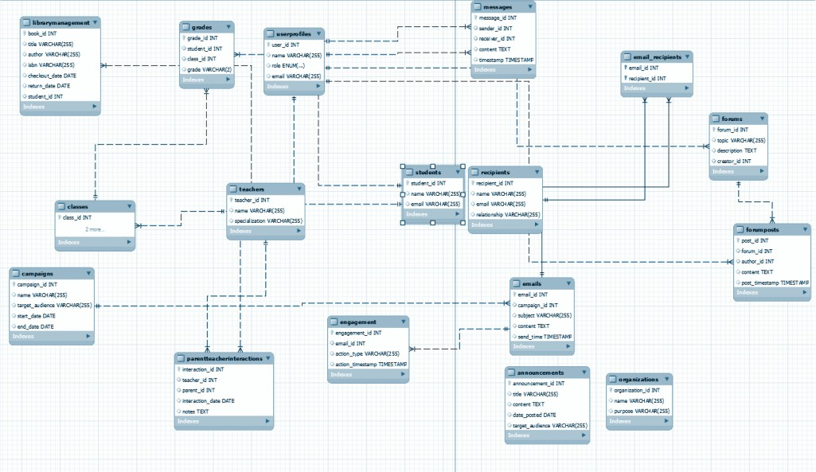

Slide 10
USER INTERFACE & SECURITY MEASURES
Intuitive, user-friendly interface for all users
Simplified navigation and data management
Advanced encryption for data protection
Secure authentication mechanisms
Regular data backups to prevent loss
Compliance with privacy regulations

Slide 11
Resources and Budget Overview
Human Resources
TECHNOLOGICAL RESOURCES
Data Resources
Database Developers
UI/UX Designers
Data Analyst
Security Expert
School Records
Licenses
Mysql
VSS
Adobe
Tableau/Power BI

Slide 12
Estimated Budget (10000$)
Development Costs: Estimated costs for the design, development, and management of the database system by the in-house team.
Technology Infrastructure: Expected expenses for using Google Cloud services for hosting the database, application server costs, and any related cloud resources.
Software Licenses: Costs associated with purchasing or subscribing to necessary software tools (excluding MySQL, as you mentioned it's not needed).
Data Management: Projections for expenses related to data storage, backup solutions, and data
integration tools on Google Cloud.
Security Measures: Anticipated investment in security software and infrastructure to protect data integrity and comply with regulations.
Training and Support: Costs for creating training materials and sessions for end-users, as well as ongoing support and maintenance.

Slide 13
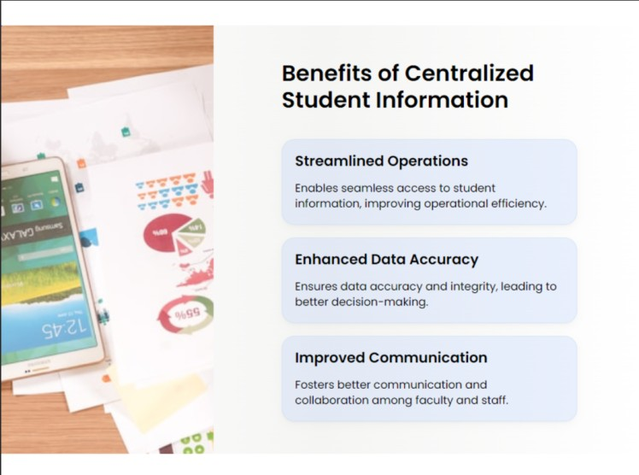

Slide 14
CONCLUSION
Our journey to modernize educational management through a comprehensive database solution has been transformative. We have prioritized efficiency, accuracy, and adaptability to meet the evolving needs of educational institutions. By leveraging cutting-edge technologies such as MySQL and sophisticated schemas, we have established a robust framework that ensures scalability, security, and user-friendliness.
Our solution not only streamlines data management processes but also empowers stakeholders with real-time insights for informed decision-making. Beyond technological advancements, we aspire to set a new standard for educational management systems nationally, fostering collaboration and engagement across all levels. As we embrace digital innovation, our commitment remains unwavering: to inspire change, empower education, and unlock the full potential of every learner in a dynamic and inclusive educational environment. Together, we envision a future where educational excellence knows no bounds.

